Slide 1
Welcome to
Governors State University

Slide 2
What is Admitted Student Day?
Establish a personal connection with our freshman students with GSU staff
Prepare students for enrollment steps – Today’s Actionable Items
Complete the deposit process
Learn more about Freshman Orientation
Prepare students to apply for housing
Confirm eligible students for the Honors Program
Review the financial aid process
Early step in establishing a community and INCREASE STUDENT SUCCESS!

Slide 3
GSU Trivia
What is the name of GSU’s Jaguar mascot?
Jax the Jaguar!
What is the nickname we have given to this campus sculpture?
French Fries!
Penguin!
What animal was GSU’s first UNOFFICIAL mascot?
HINT: This animal is always “dressed-up”

Slide 4
Fast Facts on GSU
62,000+ alumni
750 acre campus
80+ student organizations and clubs
4,338 students enrolled
12:1 student to faculty ratio
20 countries represented
#1 safest campus in Illinois
(www.niche.com/colleges/search/safest-colleges/s/illinois/?type=public)
#8 safest campus in U.S.
(backgroundchecks.org/50-safest-colleges-in-america.html)

Slide 5
Top Undergraduate Majors
Accounting, BS
Nursing, BSN
Communication, BA
Community Health, BHS
Elementary Education, BA;
English, BA;
Information Technology, BS
Interdisciplinary Studies, BA
Psychology, BA
Business Administration, BA
Criminal Justice, BA
Social Work, BSW

Slide 6
Top Graduate Majors
5. Communication Disorders, MHS
Educational Administration, MA
Counseling, MA
Occupational Therapy, MOT
Accounting, MS
Computer Science, MS
Social Work, MSW
Health Administration, MHA
Physical Therapy, DPT

Slide 7
Quality
73% rate overall experience as excellent or good*
101 average pages of assigned writing in the first year*
80% complete high-impact practices*
61.5% of GSU students receive grants and scholarships
International students from over 20 different countries
*National Survey of Student Engagement 2018
Nationally Recognized by US News and World Report
2022 Social Mobility
2022 Online Undergraduate Business Programs
2021 Ethnic Diversity
2021 Student Debt Load at Graduation – Least Debt
2021 Undergraduate Business Programs
2021 Undergraduate Computer Science Programs

Slide 8
First Year Experience

Slide 9
First Year Experience
As a GSU Freshman, you will…
-Declare an area of academic interest
-Be placed in 1 of 7 First Year Focus Areas to complete general education courses
-Work with an academic advisor who will help you develop a full-time schedule structured to ensure you succeed
-Attend classes capped at 30 students
-Learn with academic peers
-Transition into a program that best meets your needs

Slide 10
7 Focus Areas of Study
DISCOVERY
Undecided? You’re not alone! About 1/3 of all Bachelors-level students change majors in the first 3 years. Explore options under guided expertise to save money and time.
EDUCATION
Secondary Education (Biology, Chemistry, Mathematics, English}, Early Childhood Education, Elementary Education
BUSINESS
Business Administration, Entrepreneurship, Health Administration, Accounting
ARTS & ENTERTAINMENT
Fine Arts, Media Studies, Theater and Performance Studies
HUMANITIES
English, History
SOCIAL & BEHAVIORAL SCIENCES
Anthropology, Sociology, Communication, Criminal Justice, Economics, Political Science, Psychology, Social Work
STEM
Biology, Chemistry, Communication Disorders, Community Health, Computer Science, Information Technology, Mathematics, Nursing

Slide 11
First Year Experience
Laptops Provided
Lock-in your tuition rate
Make your $50 Enrollment Deposit today!
-$50 Deposit is applied directly towards your first semester’s tuition bill
-Secures your place in GSU’s LIMITED Freshman class
-You receive a $200 Book Scholarship!
May 1st for Fall

Slide 12
Jaguar LEAP Summer Immersion Program
Live, Experience, and Prepare
Saturday, July 8th - Friday, August 18th
Live: Live-on campus. Meet faculty, staff and peers. Learn campus resources.
Experience: participate in activities on campus and in downtown Chicago
CPA
The Nate
Biological Field Station
Athletics and Recreation Center
Center for Community Media
Prepare: During Jaguar LEAP, you’ll earn seven college credits, giving you a jumpstart on your first year.
Mastering College: Navigating Higher Education (1 credit)
First Year Seminar: Interdisciplinary Humanities (3 credits)
Social and Behavioral Science: General Education Course (3 credits)
Application available now: https://www.govst.edu/jaguar-leap/

Slide 13
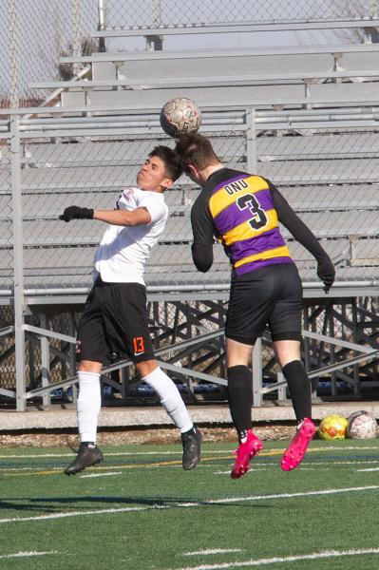
Become a Jaguar!
NAIA Collegiate Teams
-Men’s and Women’s Basketball
-Men’s and Women’s Cross Country
-Men’s and Women’s Golf
-Men’s and Women’s Soccer
-Women’s Volleyball
Varsity Reserve Teams:
-Men’s Basketball
-Men’s and Women’s Soccer
-Women’s Volleyball

Slide 14
Get Involved!
Accounting, Finance, and Economics Club
Allied Health Professional Society – Alpha Eta
Alpha Iota Sigma
American Advertising Federation – GSU Chapter
American Sign Language Club
Art Forum
Association of Latin American Students
Beta Gamma Sigma, Honor Society
Black Student Union
Chess Club
Chi Sigma Iota, Honor Society
Chinese Student Association
Coalition of Occupational Therapy Advocates for Diversity
Computer Technology Club
Criminal Justice Club
Gender and Sexuality Club (GNSX)
Generating Hope
Graduate Professional Network (GPN)
GSU Bowling Club
GSU Cheer Squad
GSU Dance Company
GSU Honors Program Student Council
GSU ICA Chapter
GSU Psychology Club
GSU Supply Chain Student Club
International Business Club
International Culture Organization
Jaguars Gaming Club
Kaleidoscope
Kappa Delta Pi, Honor Society
Lambda Pi Eta-Kappa Kappa Chapter
Male Success Initiative
Master of Public Administration Club
Muslim Students’ Association
Peer Mentor Program
Phi Alpha, Honor Society
Phoenix Newspaper
Physical Therapy Student Association
Pre-Health Club
Psi Chi Psychology National Honors Society
Reconstructed
Sigma Tau Delta – Alpha Chi Psi Chapter
Soccer Club
Social Work Student Organization
Student Activities Council
Student Education Association
Student Healthcare Management Assoc.
Student Occupational Therapy Assoc.
Student Senate
Student Veterans Organization
Students of Addition Studies Club
Sustainability Club
Table Tennis Club
Tau Sigma National, Honor Society
Trans4mation Gospel Choir
Upsilon Phi Delta, Honor Society
Wellness Club
Writers Union
Young Christian Disciples
…and you can always start a new club!

Slide 15
AIM HIGH – First Year Students
GPA Threshold
Scholarship
HS GPA: 3.5 – 4.0 $5,000 annually
HS GPA: 3.0 – 3.49 $3,000 annually
*Students must complete AIM HIGH Confirmation form as well as submit $50 enrollment deposit to secure scholarship.

Slide 16
Tuition and Fees
 | GSU Cost | Financial Aid Opportunities
Non- Residential Cost | $13,696 per year* ($54,784 Degree) | Max Pell Grant: $6,895 Max Illinois MAP Grant: $7,200 Potential Refund of $1,029
Residential Cost (Tuition, fees, housing, and meal plan) | $21,800 ($87,200 Degree) | Remaining Cost: $6,769

Slide 17
AIM HIGH Criteria
To qualify for AIM HIGH, students must:
Have attended an Illinois high school.
Be enrolled full time in a baccalaureate degree program at Governors State University for the first time.
Be a resident of Illinois.
Be a U.S. Citizen or eligible non-citizen.
Not have household income that exceeds six times the poverty rate.
Meet full admissions criteria.
Not yet have earned a baccalaureate degree or 135 undergraduate credit hours.
Not be in default of student loans or owe a refund or repayment of state or federal grants or scholarships
Scholarship

Slide 18
AIM HIGH RETENTION
To remain qualified after the first year, you must:
Continuously enroll as a full-time student (at least 12 credit hours) at GSU for Fall and Spring semesters.
Maintain Financial Aid Satisfactory Academic Progress (SAP) as outlined by the SAP Policy.
Maintain a cumulative 2.5 institutional grade point average at GSU.
Submit the FAFSA or Alternative Application for Illinois Financial Aid each year you are enrolled at GSU.

Slide 19
Financing
Your Education

Slide 20
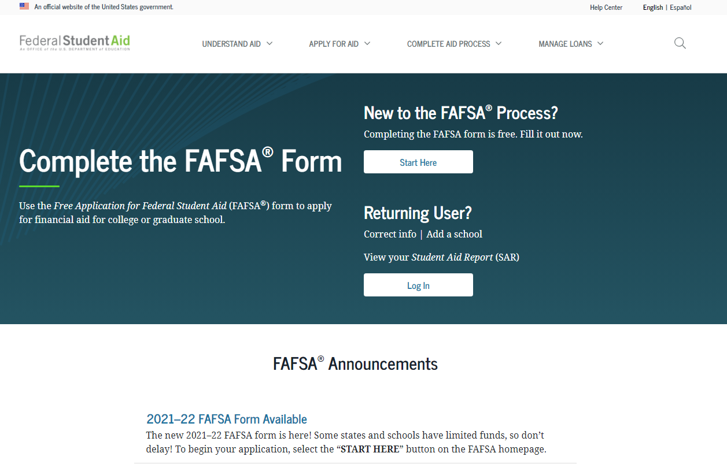
How do I apply for Financial Aid?
Starts with the #FAFSA!
(Free Application for Federal Student Aid)

Slide 21
Types of Financial Aid
1. Grants
2. Loans
3. Scholarships
4. Student Employment Opportunities

Slide 22
Grants
Federal PELL Grant
Illinois MAP Grant
Federal SEOG Grant
TEACH Grant

Slide 23
Student Loans
Federal Direct Loan
-Subsidized
-Unsubsidized
-PLUS
Private Student Loans

Slide 24
Scholarships
GSU Scholarship homepage: www.govst.edu/Scholarships/
Scholarship Universe: govst.scholarshipuniverse.com/public
With Scholarship Universe, Students will be able to:
• Answer questions and match to scholarship opportunities they are eligible for
• Easily apply online to multiple scholarship opportunities through a personalized portal
• See scholarship metrics to determine their chances and effort required to apply
• Be alerted whenever they are matched to new scholarship opportunities
• Receive automated reminders about outstanding tasks and next steps

Slide 25
Federal Work Study
Employment on or off campus
Minimum wage or higher
Gain valuable work experience
Work up to 30 hours per pay period

Slide 26
Office of Financial Aid
Phone: (708) 534-4480
Email: faid@govst.edu
Website: www.govst.edu/financialaid/

Slide 27
Housing and
Dining at GSU

Slide 28
Living on Campus
Designed to accommodate students of all class levels – first year through graduate students
Easy access to variety of campus resources – faculty, advisors, library, computer lab, rec center, bookstore, student organizations
Opportunity to take on leadership roles in your community
Develop relationships with a diverse population of people
Able to participate in late night study groups and fully participate in activities on campus
Create memories that will last a lifetime and meet people, many who will be friends for life

Slide 29
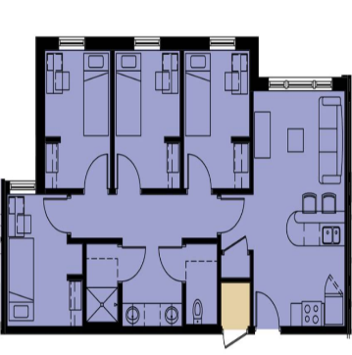
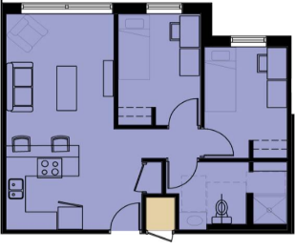
Unit Types in Prairie Place
4 bedroom apartment
(single bedroom)
2 bedroom apartment
(single bedroom) LIMITED availability

Slide 30
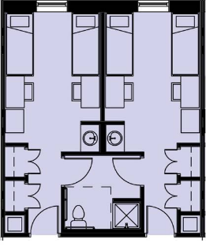
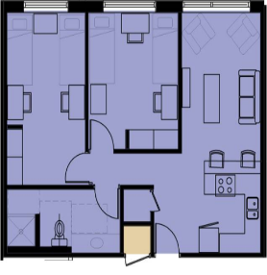
Unit Types in Prairie Place
Suite – share bedroom; bathroom
connected to next room
2 bedroom apartment – share bedroom with roommate

Slide 31
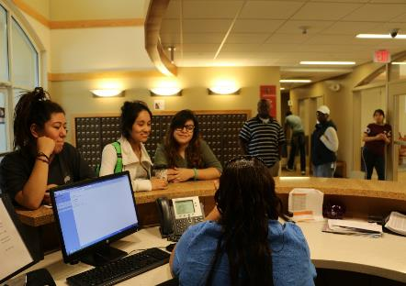
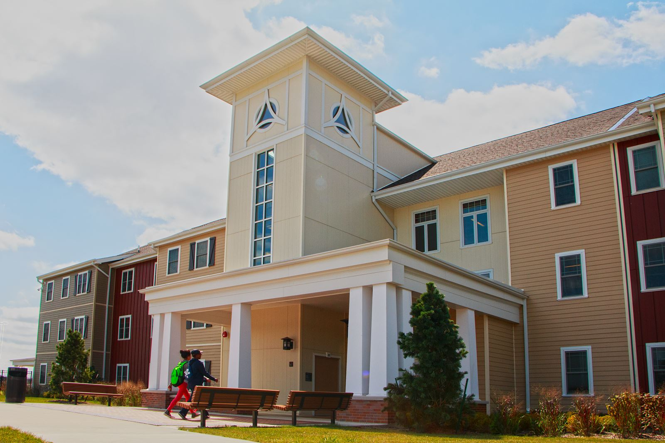
Staffing
Trained Resident Assistants
Residence Hall Director
Asst. Residence Hall Director
2 Faculty-in-Residence
24 hour front desk coverage
(Student Workers / Community Service Officers)

Slide 32
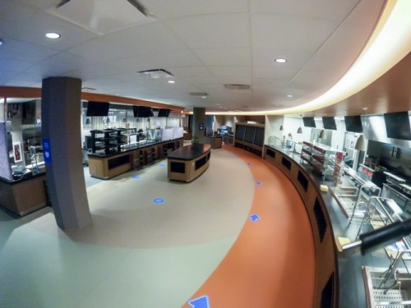
Campus Dining
Convenient & Flexible Plan
Use in Café or C-Store
Choose the plan that works for you:
Gold Plan $1,500 / semester
Silver Plan $1,000 / semester
Bronze Plan $500 / semester
*If you are a Prairie Place resident, you will be assigned a Meal Plan according to your housing room type*

Slide 33
Applying for Housing
Fall 2023 housing application will open in March 2023
Apply online at: www.govst.edu/housing
Email: housing@govst.edu
Phone: (708) 235-7110

Slide 34
GSU Honors Program
Experience

Slide 35
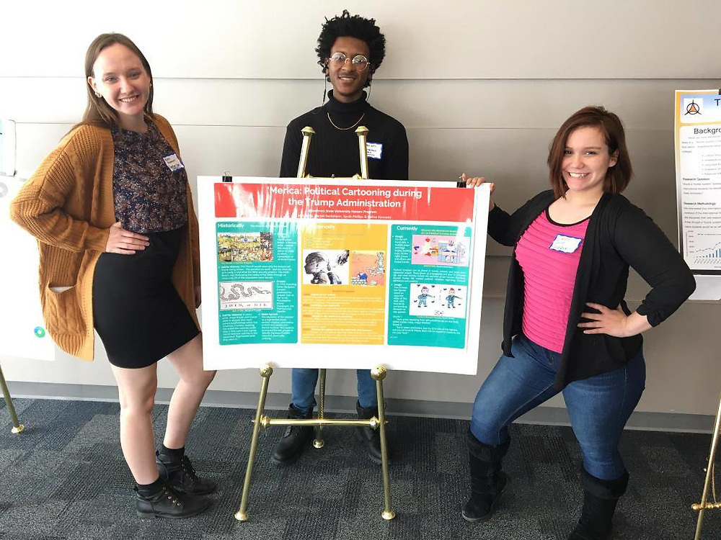
What is different about
University Honors?
Innovation
Leadership
Creating Initiatives
Community Building

Slide 36
GPATH - Guaranteed Graduate
Admissions Pathway
Start as a freshmen honors student
Finish first semester with 3.5+ GSU GPA
Second semester receive an invite to join GPATH
Retention standards apply each semester
Can still apply to GSU grad school programs through normal means if GPATH spot not retained

Slide 37
GPATH - Guaranteed Graduate
Admissions Pathway
Student gains faculty and track adviser in one of ten graduate programs.
Business – All Grad Programs (4)
Health & Human Services – OT, PT, CDIS, Informatics
Arts & Sci – Biology, Chemistry
Support for career planning, course planning, grad school readiness

Slide 38
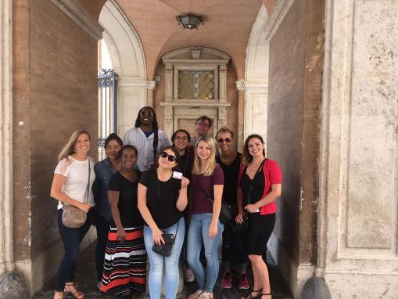
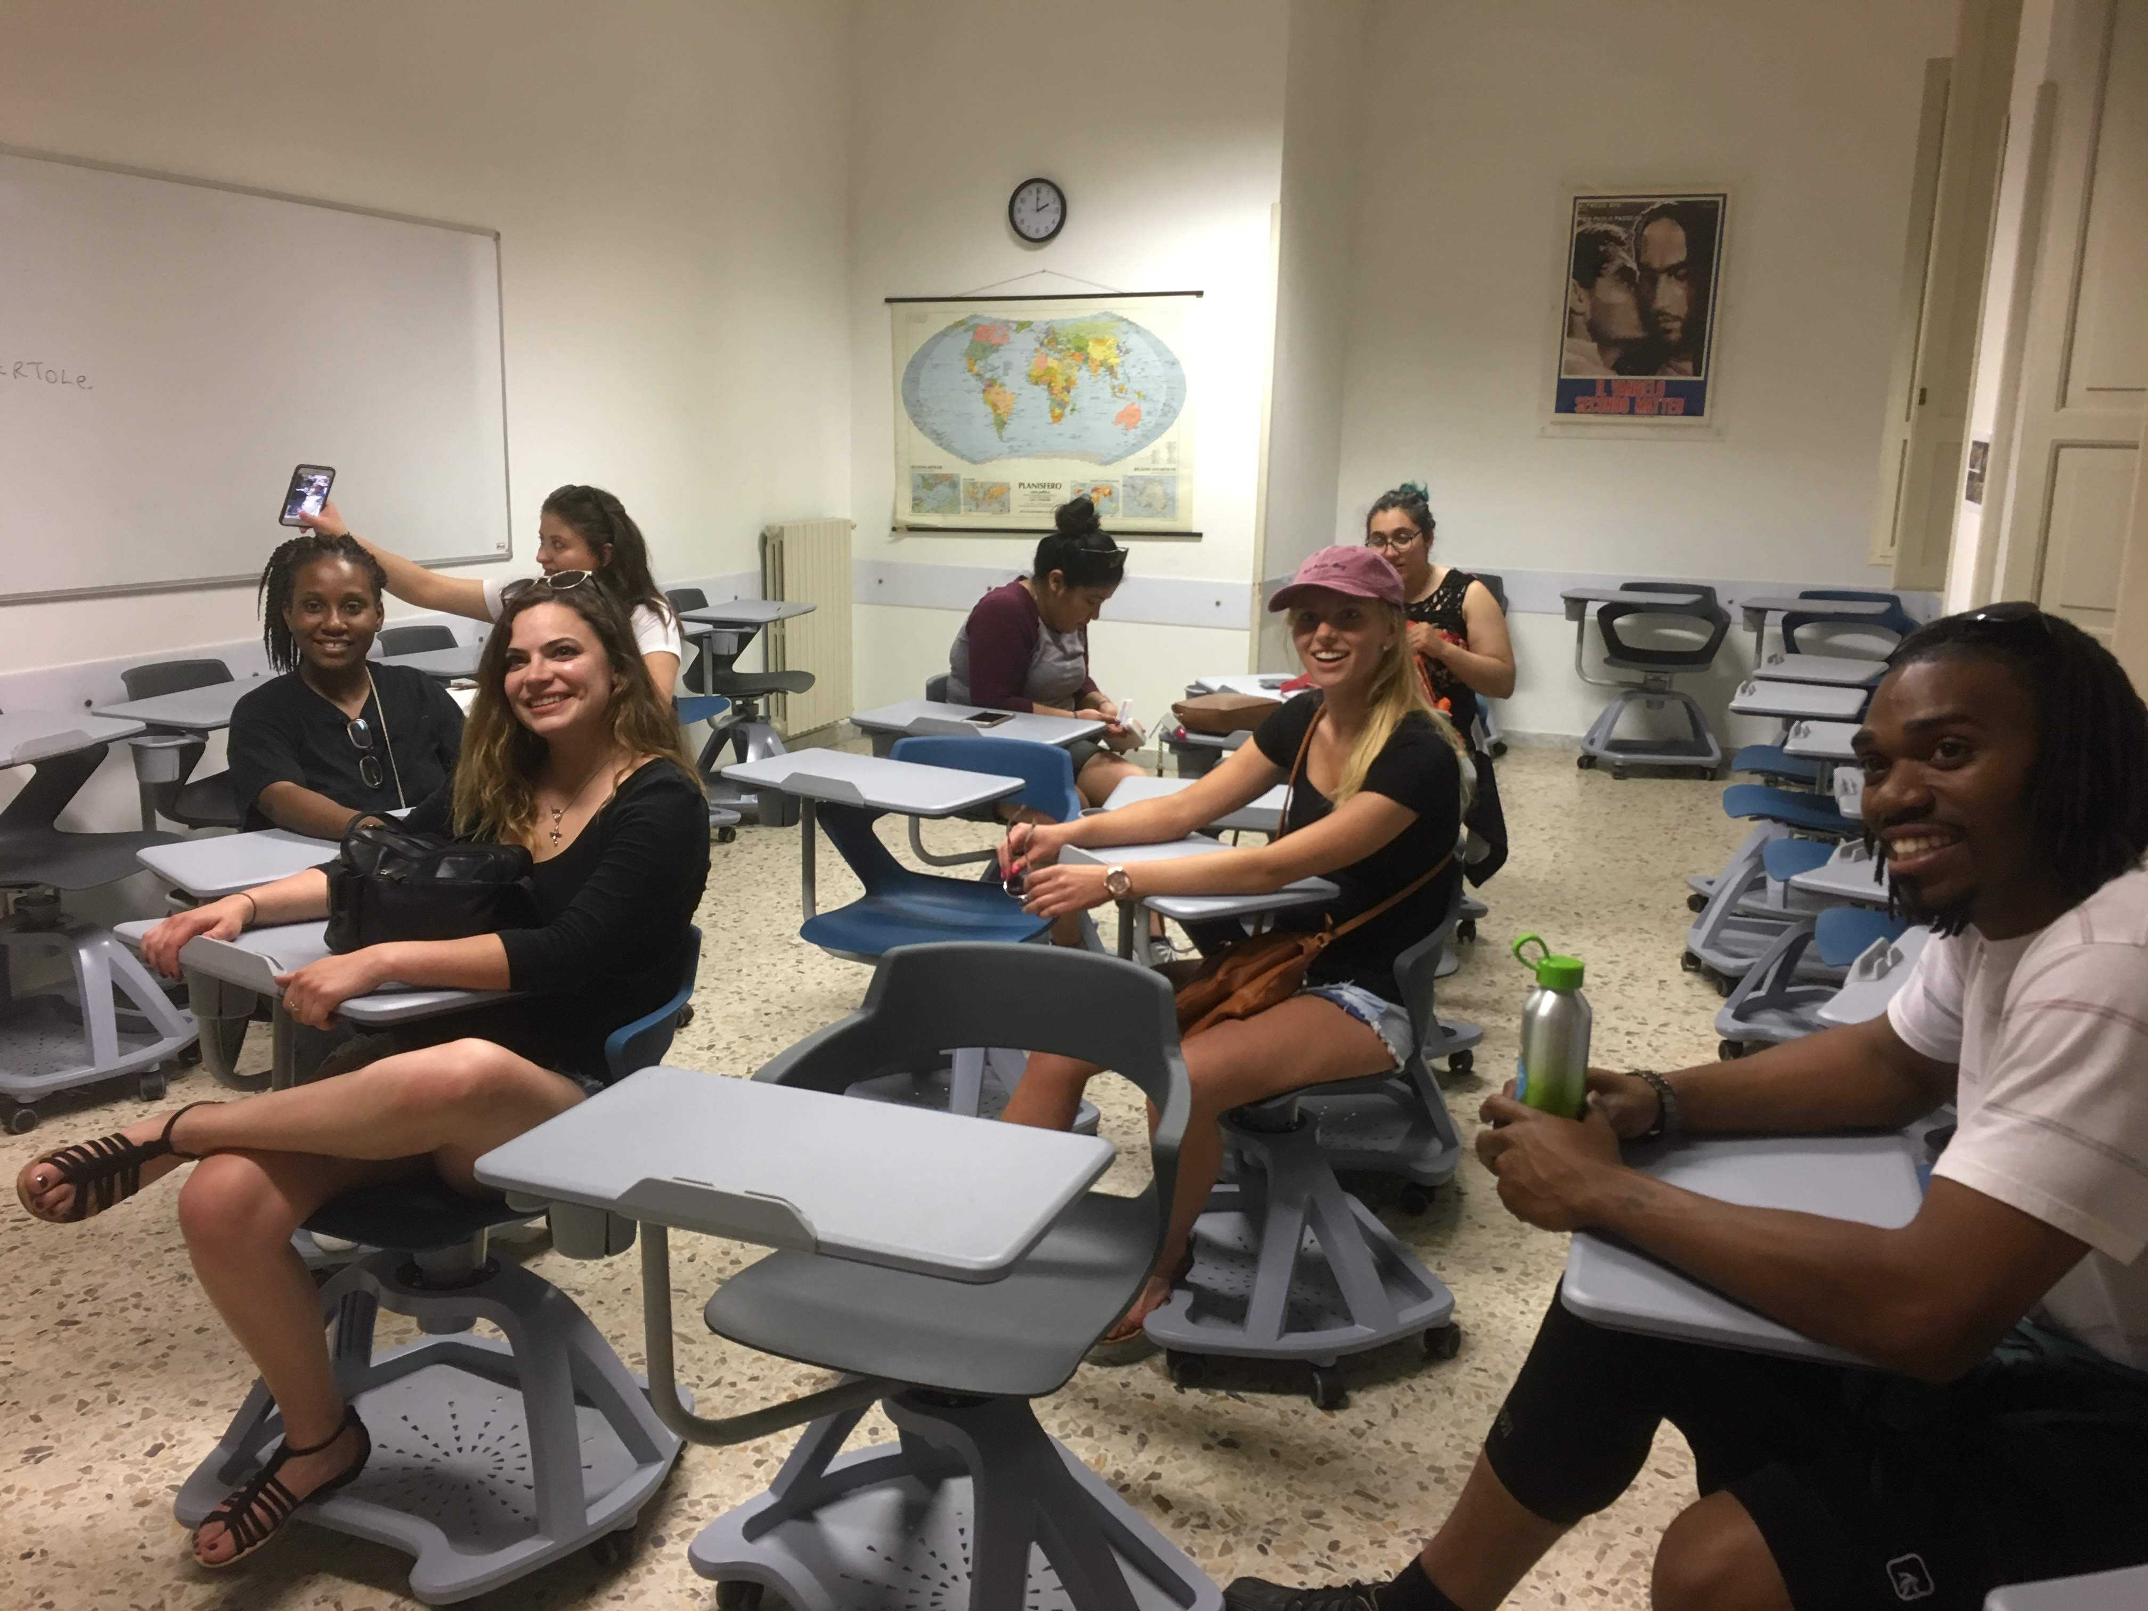
Honors Study Abroad in Rome, Italy

Slide 39
Contact Information
Dr. David Rhea, PhD
Director, University Honors Program
drhea@govst.edu

Slide 40
Admitted Freshman Checklist

Slide 41
Admitted Freshman Checklist
Get started on your journey as a Jaguar by activating your myGSU portal: You can find your login information on your admission letter.
Complete the Free Application for Federal Student Aid (FAFSA): at www.FAFSA.gov to qualify for all types of financial aid. Use GSU’s school code—009145—to make sure we receive your financial aid information.
Complete Freshman Orientation: Your journey as a GSU student begins with Freshman Orientation! We have transitioned to a fully-online format – access through the myGSU portal.
Submit your Immunization records via MedProctor. www.medproctor.com by the start of your first semester or when you move into on-campus housing.
Submit the Freshman Enrollment Deposit: Submit your deposit today!

Slide 42
Freshman Enrollment Deposit
$50 Freshman Enrollment Deposit
Credited to your student account – pre-payment on first semester’s tuition
Saves your seat in Governors State’s limited Freshman Class

Slide 43
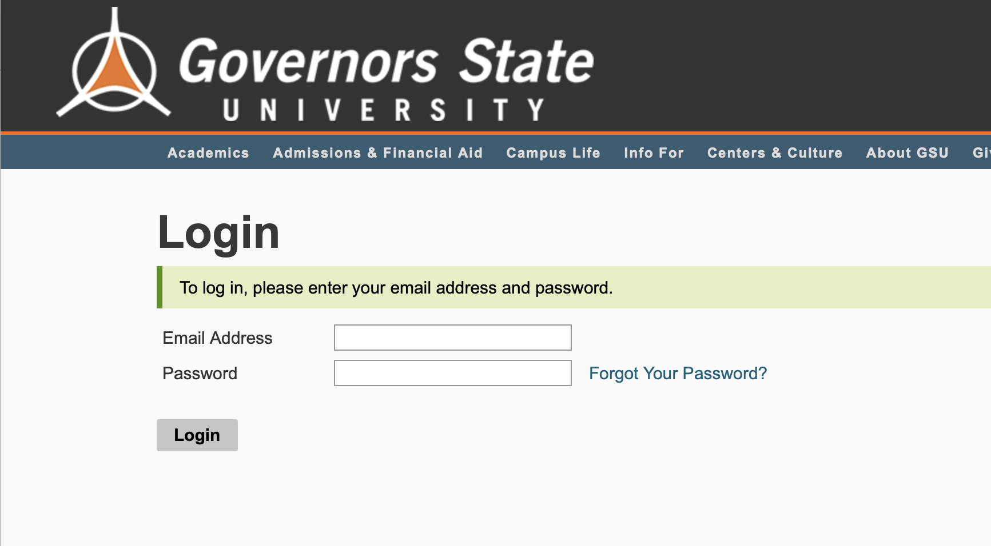
How to Deposit
Step 1: Student can now deposit in the Application Portal
apply.govst.edu/apply/status

Slide 44
How to Deposit
Step 2: Under Status Update, you will see ‘Submit Payment for 50.00 USD’

Slide 45
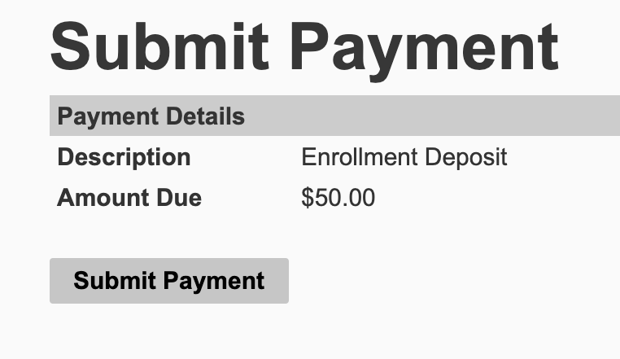
How to Deposit
Step 3: You will receive a screen that reads ‘Submit Payment’, click the button to continue

Slide 46
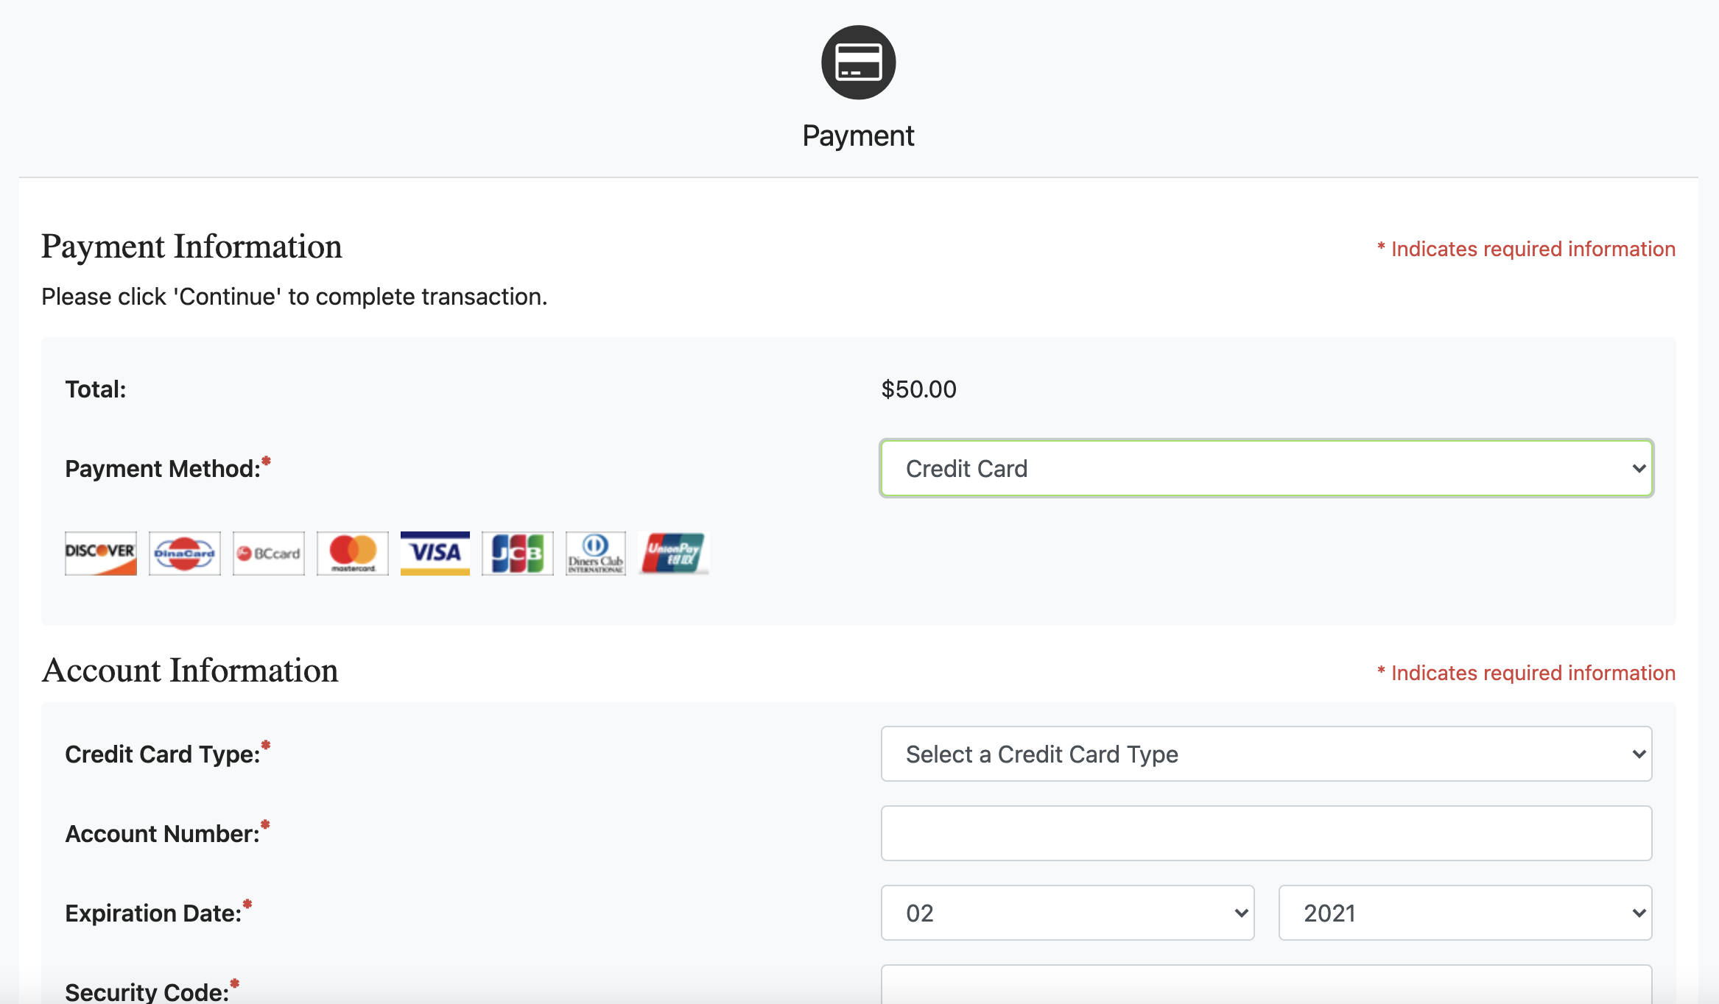
How to Deposit
Step 4: You will be logged into the secure TouchNet Payment Center to submit your Enrollment Deposit

Slide 47
Accessing Orientation
Step 1: Navigate to the myGSU Student Portal.

Slide 48
Accessing Orientation
Step 2: Log-in with your credentials, which can be found on your Acceptance Letter.

Slide 49
Accessing Orientation
Step 3: On the left-hand side, under ‘Resources’ click the Orientation button.

Slide 50
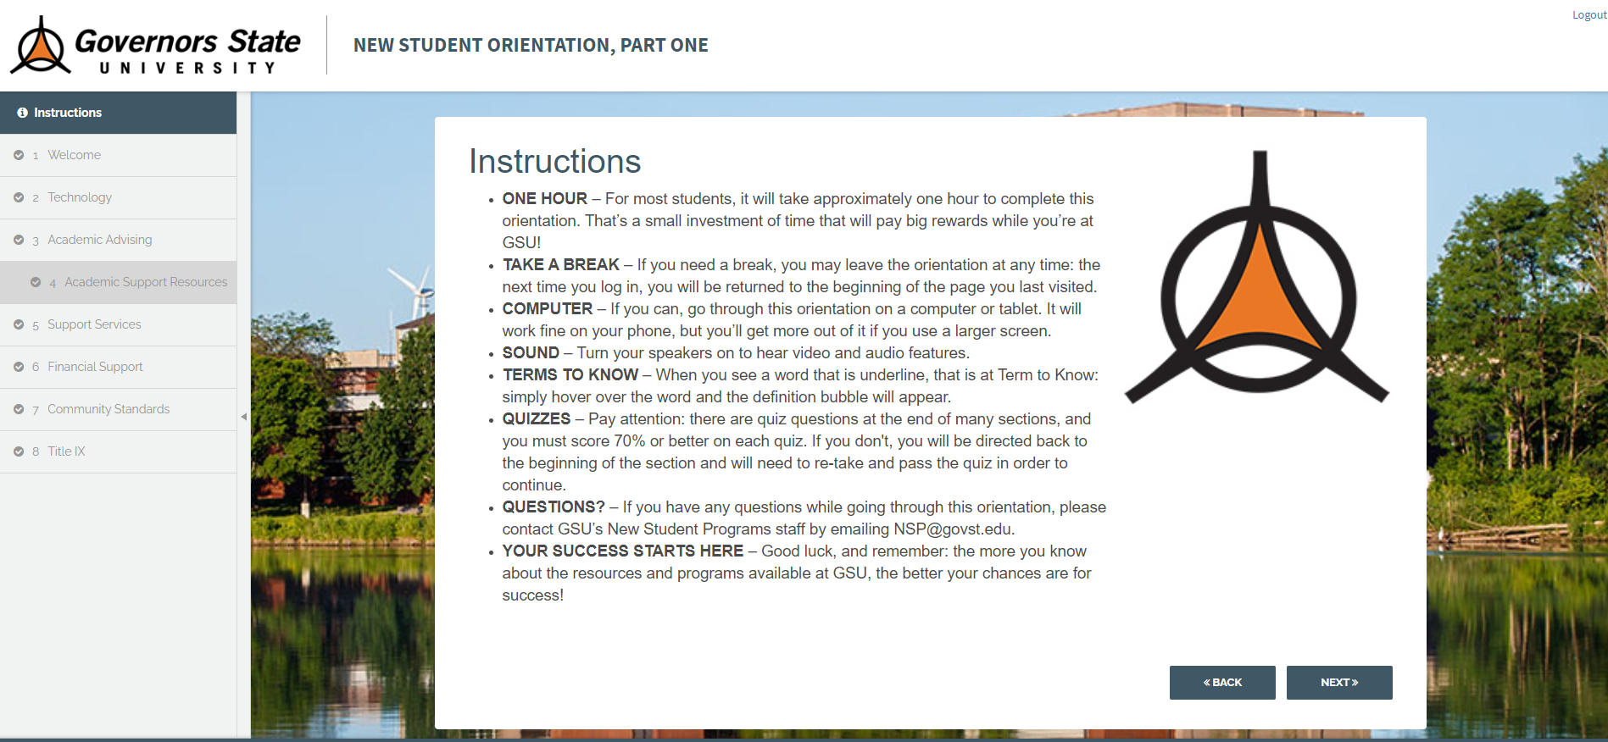
Accessing Orientation
Step 4: Complete Orientation at your own pace.

Slide 51
Accessing Financial Aid
Step 1: Navigate to the myGSU Student Portal.

Slide 52
Accessing Financial Aid
Step 2: Log-in with your credentials, which can be found on your Acceptance Letter.

Slide 53
Accessing Financial Aid
Step 3: Under the Online Services, go to the Students tab. Click on Financial Aid then My Financial Aid to see your award amounts.

Slide 54
Submitting Immunizations
Step 1: Go to MedProctor website at www.medproctor.com.

Slide 55
Submitting Immunizations
Step 2: Click “register” and create an account using your GSU student email address.

Slide 56
Submitting Immunizations
Step 3: Complete your MedProctor Profile.

Slide 57
Submitting Immunizations
Step 4: Download and Print the Immunization Certificate.

Slide 58
Submitting Immunizations
Step 5: Take the Immunization Certificate form to your medical provider for completion.

Slide 59
Submitting Immunizations
Step 6: Upload your Immunization Certificate Form to MedProctor.

Slide 60
Submitting Immunizations
NOTE: Immunization Record Compliance Deadlines:
Students admitted Fall: September 1
Students admitted Spring: February 1
Students admitted Summer: July 1
For more information about Immunizations, please visit www.govst.edu/immunizations or watch the tutorial video.

Slide 61
Admitted Freshman Checklist
Get started on your journey as a Jaguar by activating your myGSU portal: You can find your login information on your admission letter.
Complete the Free Application for Federal Student Aid (FAFSA): at www.FAFSA.gov to qualify for all types of financial aid. Use GSU’s school code—009145—to make sure we receive your financial aid information.
Complete Freshman Orientation: Your journey as a GSU student begins with Freshman Orientation! We have transitioned to a fully-online format – access through the myGSU portal.
Submit your Immunization records via MedProctor. www.medproctor.com by the start of your first semester or when you move into on-campus housing.
Submit the Freshman Enrollment Deposit: Submit your deposit today!

Slide 62
Questions?

Slide 63
Thank You!
body

